Slide 1


Fear Analysis by Demographics
Analyzing Fear Prevalence Across Demographic Groups
- Group 2
This Photo by Unknown Author is licensed under CC BY-NC-ND

Slide 2
Introduction
This project analyzes how common fears (e.g., fear of heights, spiders, public speaking, etc.) are distributed across various demographic groups.
The analysis explores potential patterns in fears based on age, gender, education level, and whether individuals live in rural or urban areas.

Slide 3

Fears and Demographics
Relevant Columns
Fears: Storm, Darkness, Heights, Spiders, Snakes, Rats, Ageing, Dangerous dogs, Fear of public speaking.
Demographics: Age, Gender, Education, Village - town.

Slide 4

Methodology
Statistical Analysis: Chi-square tests to analyze the relationship between fear and demographic factors.
Data Transformation: Numerical values (0-5) are encoded into (Low, Medium, High) Values.
Data Visualization: Graphs like bar plots, heatmaps, and other visual representations will help to interpret the findings.

Slide 5
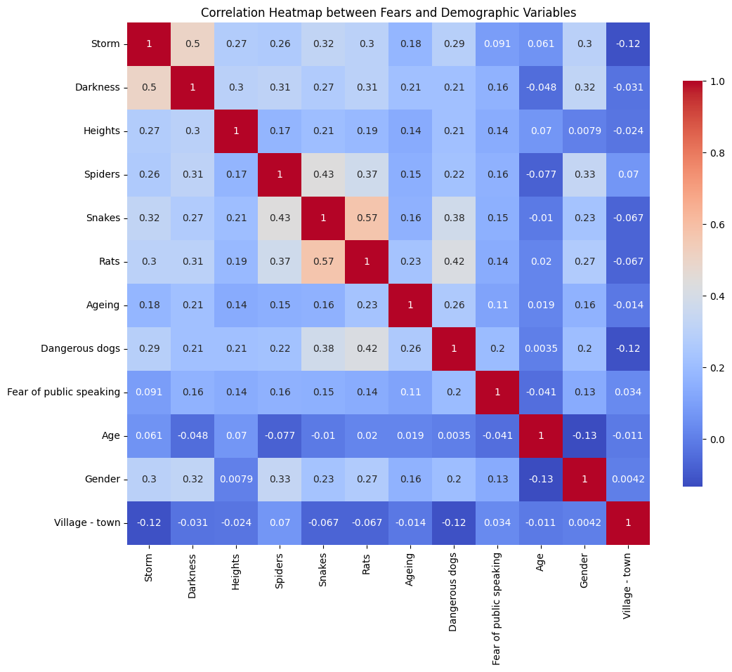
Multivariate Analysis – Correlation Matrix

Slide 6
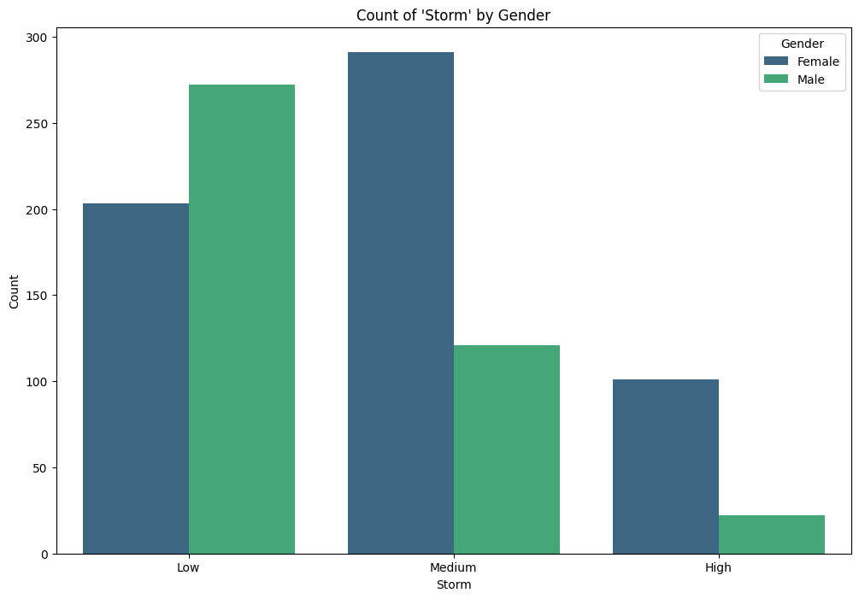
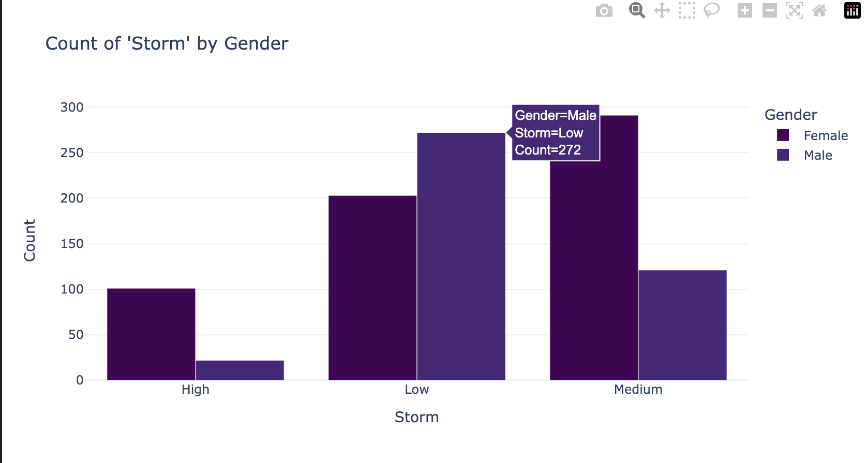
Normal Visualization vs Interactive Visualization
Normal Plot: Seaborn
Interactive Plot: Plotly

Slide 7
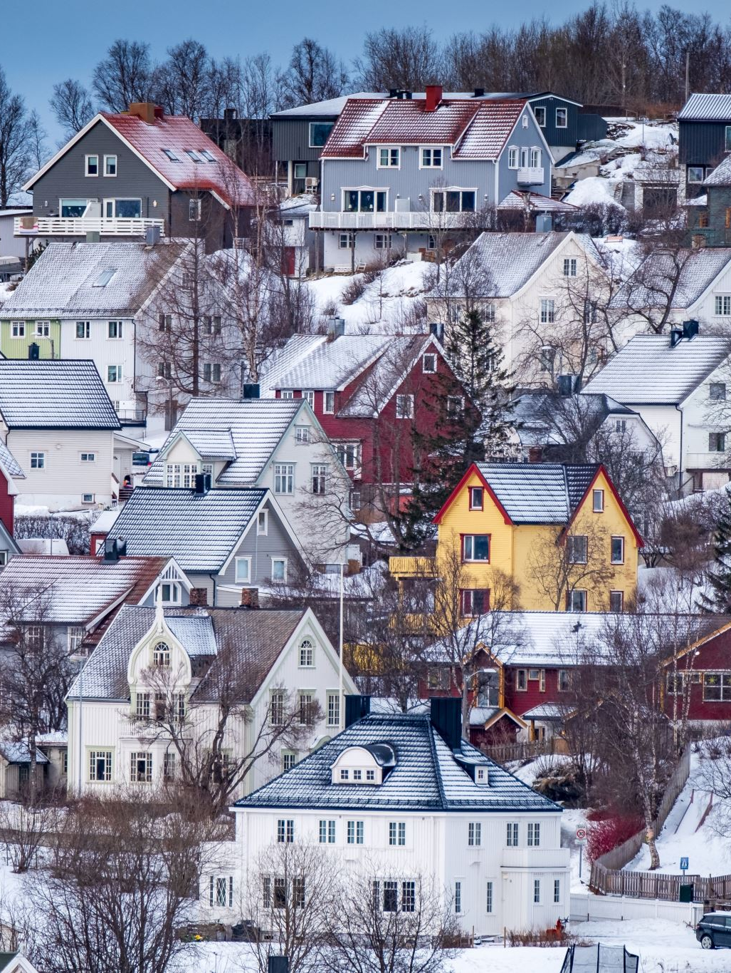
Demographic Insights by Cluster
Average Age, Gender Distribution, and Village/Town insights by cluster (from the fear clustering analysis).Example insights:
Cluster 0 (Low Fear): Mostly younger, from cities, more females.
Cluster 1 (High Fear): Older individuals, from villages, more males.
Visualization: Heatmap and Barchart for gender distribution across clusters.

Slide 8
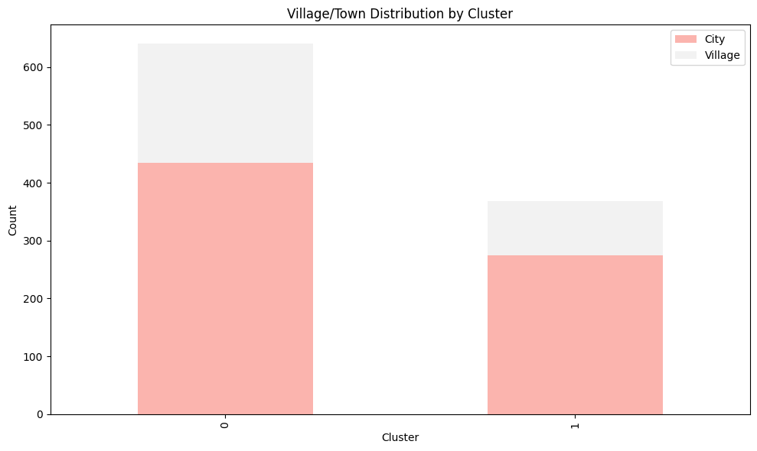
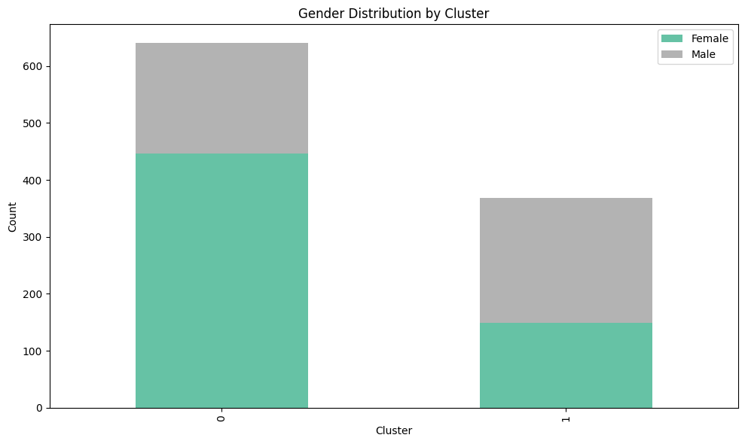
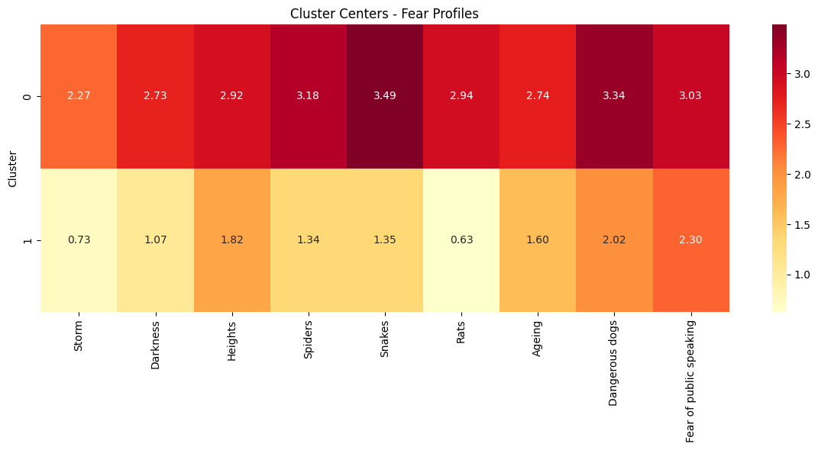
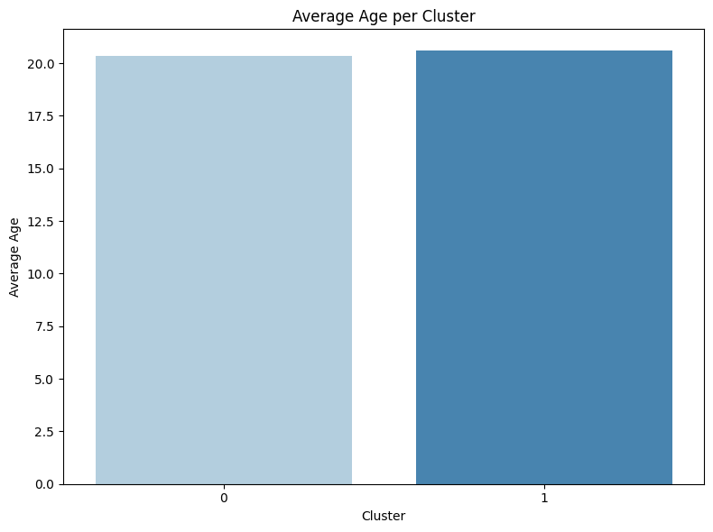
Visual Representation of Fear Profiles
Heatmap

Slide 9
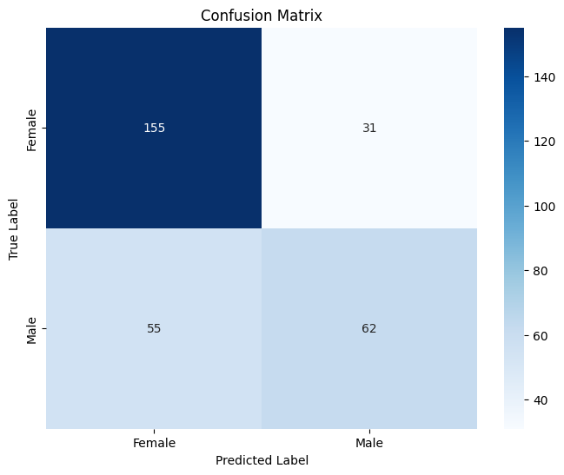
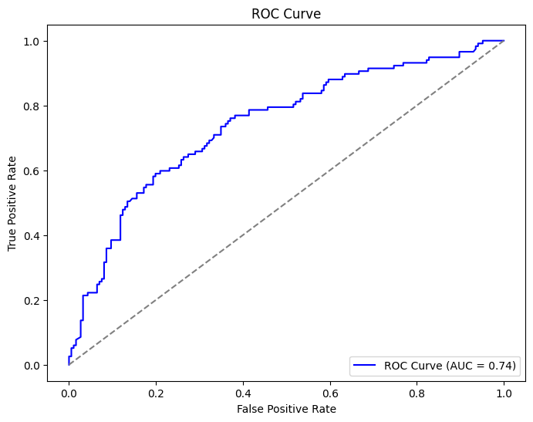
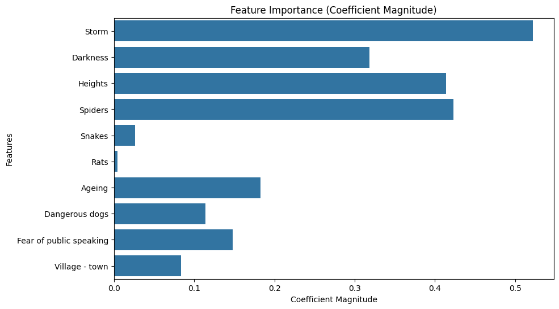
Fear Mapping and Gender Prediction using Logistic Regression
Logistic Regression for Gender Prediction
Features: Fear levels and demographic factors (Age, Village - Town).
Target: Gender (Female or Male).
Model Results
Accuracy: 0.7162
Classification Report:
Female: Precision = 0.74, Recall = 0.83, F1-Score = 0.78
Male: Precision = 0.67, Recall = 0.53, F1-Score = 0.59
Overall: Accuracy = 72%, Macro Avg: 0.69, Weighted Avg: 0.71

Slide 10
Conclusion
Cluster Analysis:
Cluster Groups: The clustering analysis revealed distinct groups based on fear profiles, with the clusters showing significant variation in fear levels across different categories (e.g., Low, Medium, High).
Demographic Insights: The demographic analysis by cluster highlighted patterns based on age, gender, and village/town. Cluster 0 had a higher percentage of Females and City residents, while Cluster 1 had more Males and Village residents.
Logistic Regression (Gender Prediction):
Predicting Gender: Logistic regression used fear levels (encoded as numeric values) and demographic features (Age, Village - town) to predict gender (Male/Female).
Model Accuracy: The model achieved a 72% accuracy in predicting gender, with better performance for predicting Females (83% recall) compared to Males (53% recall). This indicates that fear factors are a stronger indicator for identifying females than males in this dataset.
Performance Metrics: The classification report demonstrated that the model's precision and recall differed by gender, with higher precision for Females and lower recall for Males, suggesting areas for improvement in gender prediction based on fear data.

